Slide 1

Sam Becker

Slide 2

Introduction
Why is it important?
Security
  Why is it needed?
  Solution Schemes
Questions

Slide 3

What is cloud computing?
  Using someone else’s hardware and software
  Internet/Browser based
  Examples:
    Amazon’s EC₂ and S₃
    IBM’s Smart Business cloud
    Microsoft’s Azure
    Google’s AppEngine
    Salesforce (SaaS)

Slide 4

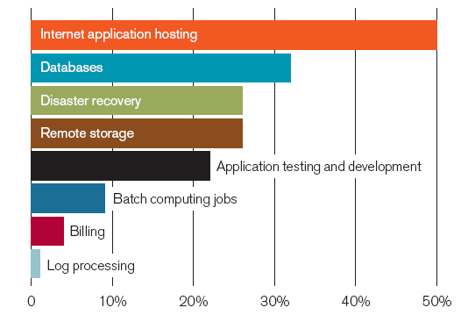
Allows anyone to have extreme computing power
Lets small businesses prosper
Reduced costs of large companies
No Google(oh noes!!)
Cloud Usage

Slide 5

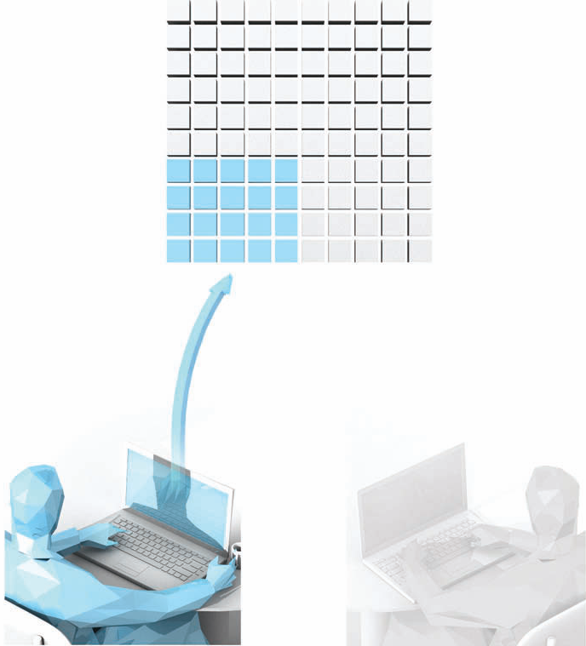
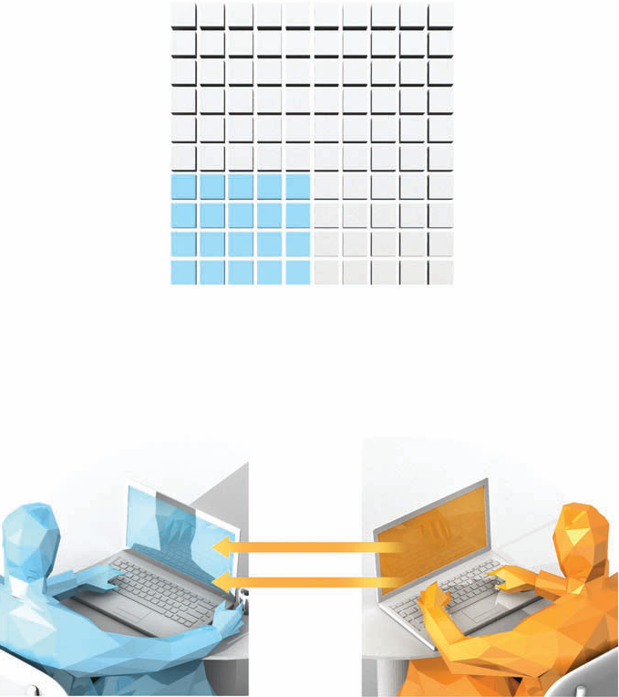
Many clients share the same hardware
MIT group showed they can monitor other users
Victim
Bombard Victim with requests

Slide 6
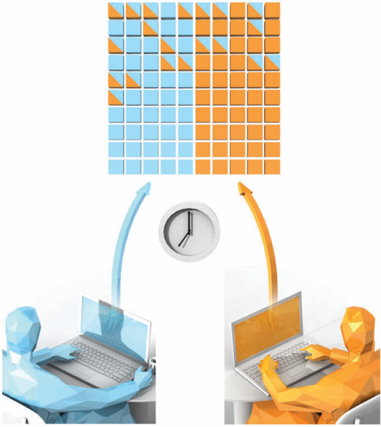
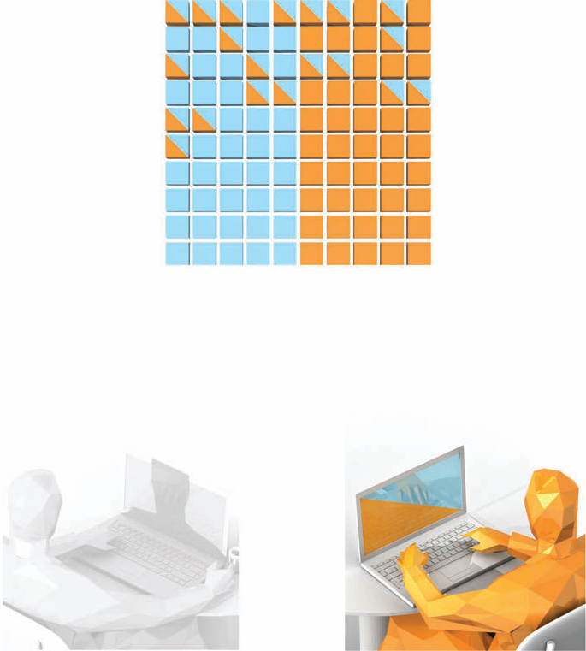
Hire VMs at the same time
Monitor victim and steal data

Slide 7

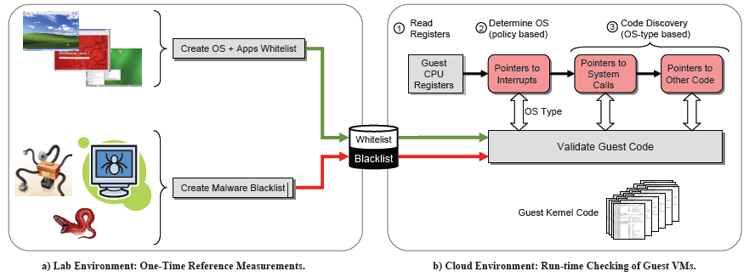
Pros: Doesn’t take a lot of computing power
Cons: Makes assumptions that can’t all be met

Slide 8

Pros: Very secure
Cons: Defeats purpose of cloud
Have to download encrypted data and decrypt before working on it
Searching requires special metadata

Slide 9

Pros: Very secure, allows any calculation on encrypted data
Cons: Takes too much computing power
Gentry’s Algorithm
  Uses ideal lattices to do calculations and returns encrypted answer
  Public key
  Not efficient enough for use yet

Slide 10


Slide 11

CHRISTODORESCU, M., SAILER, R., SCHALES, D. L., SGANDURRA, D., AND ZAMBONI, D. 2009. Cloud security is not (just) virtualization security: a short paper. In Proceedings of the 2009 ACM Workshop on Cloud Computing Security,97-102.
GENTRY, C. 2009. Fully homomorphic encryption using ideal lattices. In Proceedings of the 41st Annual ACM Symposium on theory of Computing, 169-178.
GOOGLE HISTORY. 2010. Google. (http://www.google.com/corporate/history.html.)
MOHAMED, A. 2009. A history of cloud computing. Computer Weekly.( http://www.computerweekly.com/Articles/2009/06/10/235429/A-history-of-cloud-computing.htm.)
RISTENPART, T., TROMER, E., SHACHAM, H., AND SAVAGE, S. 2009. Hey, you, get off of my cloud: exploring information leakage in third-party compute clouds. In Proceedings of the 16th ACM Conference on Computer and Communications Security, 199-212.
STEAM CLOUD ROLLING IN THIS WEEK. 2008. Steam. (http://store.steampowered.com/news/1968/.)
TALBOT, D. 2010. Security in the Ether. Technology Review, 113(1), 36-42. Retrieved from Academic Search Premier database.
WEI, J., ZHANG, X., AMMONS, G., BALA, V., AND NING, P. 2009. Managing security of virtual machine images in a cloud environment. In Proceedings of the 2009 ACM Workshop on Cloud Computing Security, 91-96.

